Slide 1

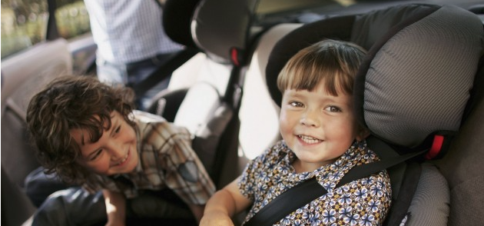
Ad Council
Child Passenger Safety Research General Market
August, 2015
C&C Multicultural, LLC
Strategic Research

Slide 2
Project Background and Objectives
Situation | According to the National Highway Traffic Safety (NHTSA) 2012 child fatality data, car crashes are a leading cause of death for children 1—12 in America. However, this fatality rate could be greatly reduced if the correct child safety seats were always used. Even though parents and caregivers do everything they can to protect their children, children are still being killed or injured due to lack of knowledge about restraint use during a child’s development. The overall purpose of this research is to increase awareness about proper restraint use for children up to age 12. Creative concepts will be tested in order to determine which one is most impactful and motivates respondents to seek more information.
Specific Objectives | Obtain feedback from respondents before final production to assess create effectiveness of proposed concepts. We will explore the following Message comprehension: Explore if the main message is coming through and if there is any confusion Relevancy and meaningfulness: Explore if concept resonates at a personal level and understand emotional connection Likes/dislikes and any concerns Motivation and action: Understand the extent to which the concept increases interest in learning more about child passenger safety
Page 2

Slide 3

Who we talked to
  Ages between 18 and 65 (good mix)
  Parents/caregivers with children of mixed ages ranging from 0 to 12
  Drive with their kid(s) in the car at least 3 times/week
  Mix of income representative of each market
  Mix of gender
  Mix of marital status
Chicago
Atlanta
Six mini-focus groups with General Market parents of kids ages 0-12
3 groups in Chicago, 3 in Atlanta
2 groups of parents/caregivers with kids ages 0-3, 2 with parents/caregivers of kids ages 4-7, and 2 with parents/caregivers of kids ages 8-12
Groups representative of market-Mix ethnicities
Page 3

Slide 4
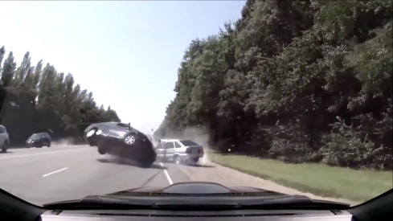
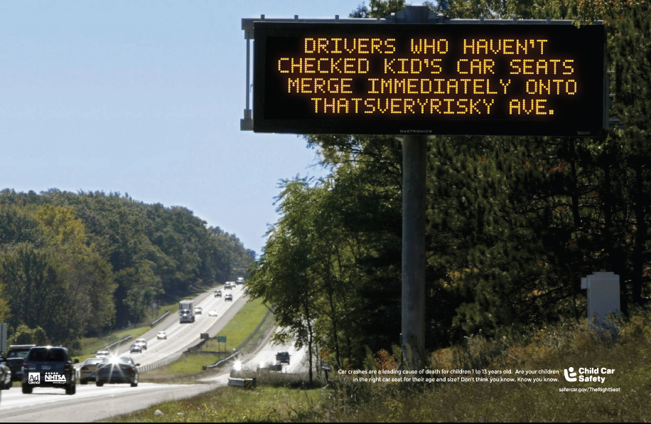
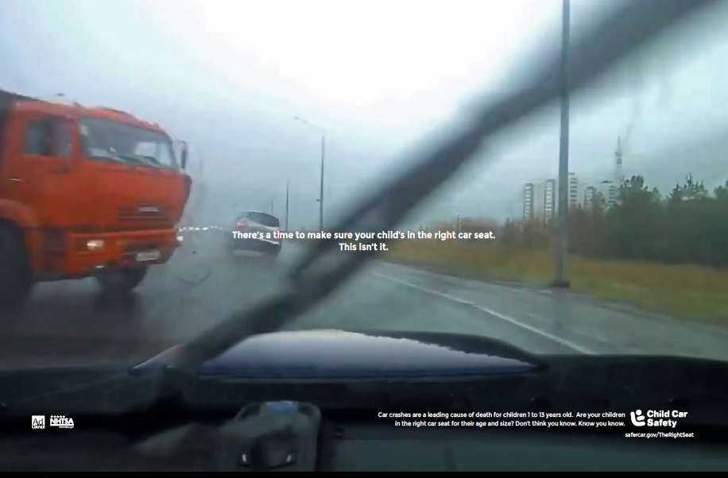


Concepts Reviewed
Dash Cam
(1 TV, 1 Radio and 3 Print)
Your Exit
(1 TV, 1 Radio and 3 Print)
Page 4

Slide 5
Key Findings

Slide 6
Overview of Reactions to Campaigns
Of the two campaigns, Dash Cam’s more serious and realistic approach was more impactful and motivating respondents.
However, respondent reactions to elements in both campaigns revealed opportunities for optimization across both concepts.
Your
Exit
Dash
Cam
Dash
Cam
Your
Exit
The ‘Dash Cam’ concept’s realistic and serious approach together with the tagline made an impression on respondents. However, the concept’s connection to child car seat safety was not immediately clear in the TV spot to all due to absence of imagery/audio of children and/or car seats in the executions.
Overall, ‘Your Exit’ concept’s softer tone was appealing, but had to work harder to motivate respondents. Additionally, the humorous tone of the TV and print ads was perceived to weaken the message. The play on words in the signage also generated some confusion. However, imagery of the child and mother in the TV ad strengthened the message and was appealing to respondents.
Page 6

Slide 7

Reactions to the Tagline and Statistic
The tagline and statistic were powerful elements across both campaigns.
The tagline in the TV ads was provocative and compelling– leading respondents to rethink and question their current assumptions about car seat safety.
Respondents also often noticed the statistic in the print ad, which augmented the message’s relevance and credibility.
Tagline is provocative and compelling
Statistic strengthens the message’s credibility and call to action

Slide 8



Reactions to the ‘Dash Cam’ Concept
Dash
Cam
The ‘Dash Cam’ concept’s realistic and serious approach together with the tagline made an impression on respondents.
The research further revealed opportunities for optimization that could strengthen Dash Cam’s comprehension and relevance across all executions.
Imagery in the spot was impactful and together with the tagline, was very powerful and effective in driving home the message. However, without imagery/audio of the child and car seat, connection to message was not always immediately clear.
The radio ad generated mixed reactions. Many perceived the ‘over-confident’ voices in the spot to represent parents who are irresponsible, and therefore most could not identify with them. The voice that depicted uncertainty, however, was very relatable and impactful.
Messaging in the print ad is clear and imagery draws viewer into the scenario, creating a strong sense of urgency. However, messaging in some of the print ads was perceived as too harsh, dramatic, and/or morbid by some respondents.
Page 8

Slide 9
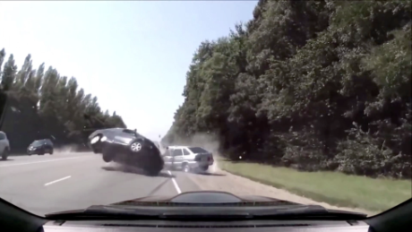
Reactions to TV
Dash
Cam
What worked | What didn’t work
To the point, message clear. Triggered an emotional response – feeling of ‘Oh my God!’, fear, concern, panic. Some described imagery as gut-wrenching, intense, vivid. Strong call to action and ‘dramatic sense of urgency’ to check NOW Tagline at the end reinforced message and call to action – made it relevant, very vivid, powerful, and personal Considered very informative – made respondents think about safety for their children and was a reminder to be prepared. | While message was clearly understood, many did not immediately make connection between the ad and children’s car seat safety. Some felt parents would not take notice of ad without this imagery. Many felt there was no resolution at the end (showing the child safe in a car seat) – does not inform parents on what they should do or how they should do it. A few felt they were desensitized to this approach, and the theme felt overplayed Compared the approach to the “don’t drive and text” campaign A few in Chicago, saw it as a scary tactic, over the top, too harsh, and negative.
Opportunities for Optimization
To strengthen connection between message and ad, and create a stronger call to action, consider incorporating imagery/audio of children in their car seats into the executions. Highlight statistic and call-to-action in the spot to reinforce credibility.
Imagery in the spot was impactful and together with the tagline, was very powerful and effective in driving home message. However, without imagery/audio of the child and car seat, connection to message was not always immediately clear.
Page 9
Heard strongly across groups

Slide 10
Reactions to Radio (Over Confident)
Dash
Cam
What worked | What didn’t work
Message clearly conveyed the importance of knowing, not assuming car seat is safe. Sounds of wheels screeching between voices, as well as variety of voices attracted and kept their attention. Perceived to be relevant largely due to voice that conveys uncertainty which resonated with respondents. Message perceived to be informative, helpful, enlightening. Many noticed the website and mentioned they would to there to get more information. | People in ad perceived as irresponsible and idiotic for making assumptions about their child’s safety. Target perceived them as irresponsible parents so they distanced themselves from these parents. Sounds of wheels screeching between the voices perceived as silly, unrealistic, unnatural, humorous - not a good fit with the potential tragedy. A few thought the line at the end of the spot, “I know my child is in the right car seat, I just checked it a minute ago,” was a little silly and could be improved. Some pointed out that the ad should mention statistic to make more impactful.
Opportunities for Optimization
Shifting from an over-confident/arrogant tone to one of uncertainty more strongly reflects how parents see themselves and has the potential to motivate parents to act. Consider improving the line at the end of the spot by incorporating the website into the copy and using this opportunity to re-emphasize the website name and further clarify the call to action. One possible way of incorporating the website name may be something along the lines of, “I just checked on SaferCar.gov/TheRightSeat, so I KNOW my car seat is safe.” Make tagline more pronounced and include statistic to maximize impact and reinforce call to action.
The radio ad generated mixed reactions.
Many perceived the ‘over-confident’ voices in the spot to represent parents who are irresponsible, and therefore most could not identify with them. The voice that depicted uncertainty, however, was very relatable and impactful to respondents.
Page 10

Slide 11
Reactions to Voices in Radio
(Over Confident)
Dash
Cam
Many disliked the over confident tone of the voices in the ad but could relate to that voice that reflects uncertainty. Ensuring that the right tone comes across clearly will be key.
  Overconfident Voice
Uncertain Voice
  Parents cannot relate: Voices perceived to be of parents who are arrogant and idiotic, leading many to dismiss the spot as irrelevant.
  Parents can relate: Most could identify with thoughts expressed by this voice; therefore many found it to be motivating and impactful.
  “Of course my kid’s in the right car seat. I just checked it two years ago”
  Rear facing, forward facing, does it really matter?
  Yeah, my kid’s in the booster seat, he was ready…I think.
Opportunities for optimization
It will be important to ensure during casting that the tone of uncertainty comes across clearly an convincingly to ensure that the intended message is communicated and that will help remove any confusion with a voice that sounds arrogant or cocky.
  Her car seat looks totally safe…from my rearview mirror.
  There are probably rules on when to move to a booster seat, but I’m going with my gut.
Page 11

Slide 12
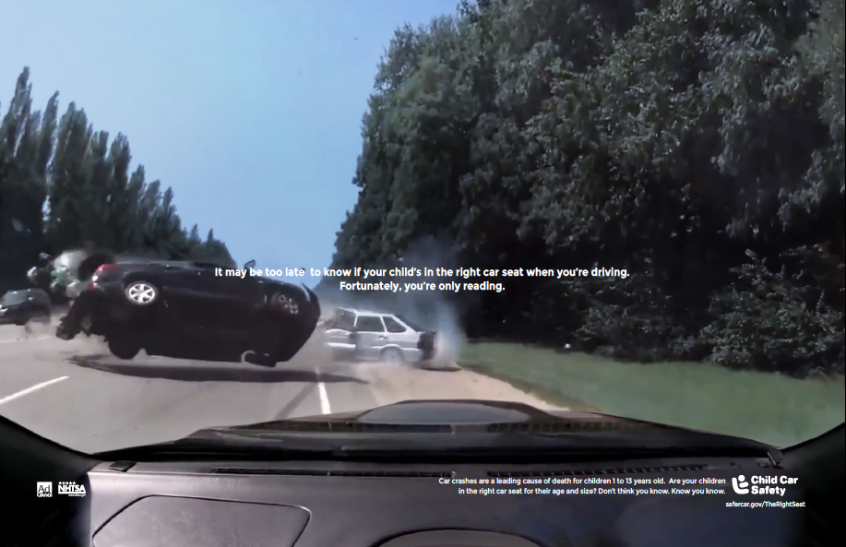
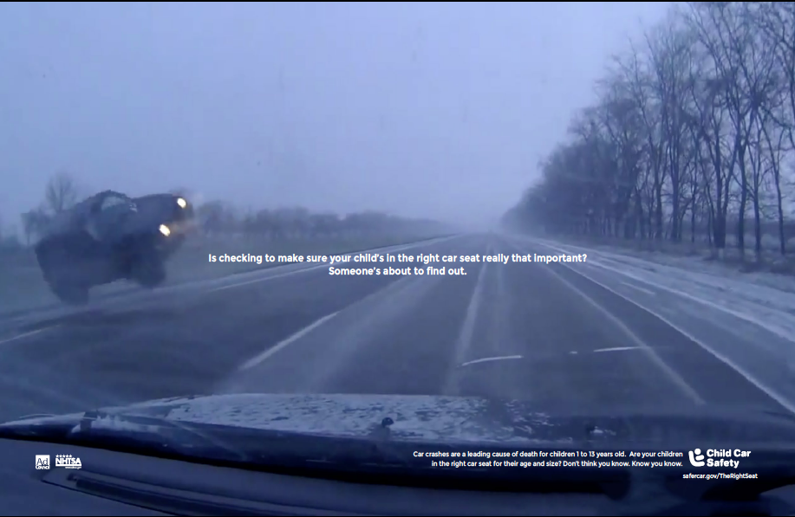
Reactions to Print
Dash
Cam
Future
Messaging in the print ads is clear and imagery impactful – draws viewer into the scenario and creates a strong sense of urgency.
However, some respondents perceived messaging in some of the print ads to be a little harsh and dramatic
It may be too late to know if your child’s in the right car seat when you’re driving. Fortunately, you’re only reading. | There’s a time to make sure your child’s in the right car seat. This isn’t it. | Is checking to make sure your child’s in the right car seat really that important? Someone’s about to find out.
Reactions by Execution:
Image of car flipping was powerful and made respondents think that it could happen to them. The phrase ‘Fortunately you’re just reading’ threw message off for some, not clear it was directed to them as the reader or to someone in the imagery. | Imagery and messaging effective in driving home message. Resonated emotionally, while others perceived the shock value to be too much. Simple to the point, perceived to put them in the drivers’ seat – with onus or responsibility on them. | Message and imagery clear and impactful. Some liked the question, perceived to be provocative, made them question themselves. Some perceived the phrase: ‘someone’s about to find out’ to be a little harsh.
Reactions Overall
Statistics noticed by many, reinforces credibility. Tagline strong and powerful, but not pronounced enough in the ads. Text too small, difficult to read.
Opportunities for optimization
Avoid using tones that can be perceived as ill-wishing. While the ad is trying to shake people, some had an issue with “Someone’s about to find out”. Consider incorporating a provocative question that challenges current assumptions. Make tagline and stats more pronounced to maximize impact and create stronger call to action. A stronger call-to-action will help provide relief to the discomfort people experienced.
Page 12

Slide 13
Reactions to ‘Your Exit’
Your
Exit
The “Your Exit” concept had to work harder to get respondents to consider taking action. The use of humor weakened the message, and the play on words in the signage generated some confusion. However, imagery of the child and mother in the TV ad and serious tone in the radio spot, reinforced the message and was appealing to respondents.
Overall, respondents understood message but because the spot was less dramatic, it wasn’t as motivating to parents. Additionally, road signage confused some and many perceived the music as silly and inappropriate for the topic.
The radio spot was appealing and motivating. The use of metaphors and signs led parents to question their assumptions around car seat safety, and made them reflect, rethink and question current behavior.
Messaging in the print ads was clear; however, messaging in some of the ads was perceived as too silly and/or forceful and signage was difficult to read. Additionally, the highway billboard imagery generated some confusion.
Page 13

Slide 14
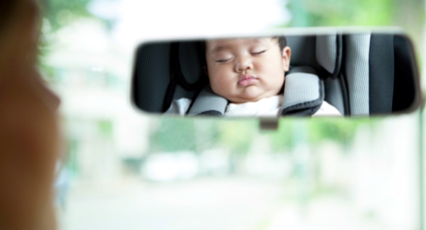
Reactions to TV
Your
Exit
What worked | What didn’t work
Most understood message, which was reinforced by the tagline at the end of the spot. Imagery of the mother and child in the car seat quickly conveyed that ad was about child in car seat. Good connection between mom and child –mother looking back at child conveys mother is careful, protective. Generated feeling of concern, worry to make sure child is in the right car seat (for some) Short and to the point | Overall the ad had to work harder to motivate parents to act – did not seem to have a strong call to action. Signage was difficult to read for many which created confusion. Words close together also perceived as silly, strange, unrealistic. Many did not like PushingYourLuck Blvd reference, perceived as “dumb” and “cheesy”. A few took signage message literally and questioned if the signs were actually going to one day exist on the roads. Music perceived to be silly and not fit with seriousness of message.
Opportunities for optimization
Change tone of music to match the seriousness of the topic. Highlight statistic in the spot to reinforce credibility.
Overall, respondents understood message but as the spot was less dramatic, the ad wasn’t as motivating to parents. Additionally, road signage confused some and many perceived the music as silly and inappropriate for the topic.
Page 14

Slide 15
Reactions to Radio
Your
Exit
The radio spot was appealing and motivating. The use of metaphors and signs led parents to question their assumptions around car seat safety, and made them reflect, rethink and question current behavior.
What worked | What didn’t work
Tone perceived as serious and yet soft- Many described tone as good, balanced, reassuring, calm, honest, caring, positive, not fear inducing. Most could relate to metaphors in the ad, which helped respondents understand the importance of ensuring car seats are safe. The signs were effective in making parents question their current assumptions - made them stop and think. Perceived to provide good information and guidance; many remembered the URL mentioned at the end of the spot. | Some perceived ad to be too long, too many signs. Described as confusing, too mellow, wordy, boring, redundant. A few respondents did not seem to understand how metaphors could apply to children’s safety on the highway.
Opportunities for optimization
Consider providing different types of metaphors (not just highway related) to keep listeners engaged in spot. Consider the number of metaphors in the story to maintain attention span and engagement. Inject more energy into the spot, while maintaining the serious tone. Make tagline and stats more pronounced to maximize impact and create stronger call to action.
Page 15

Slide 16
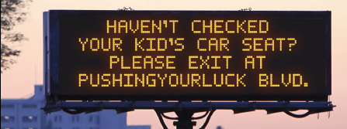
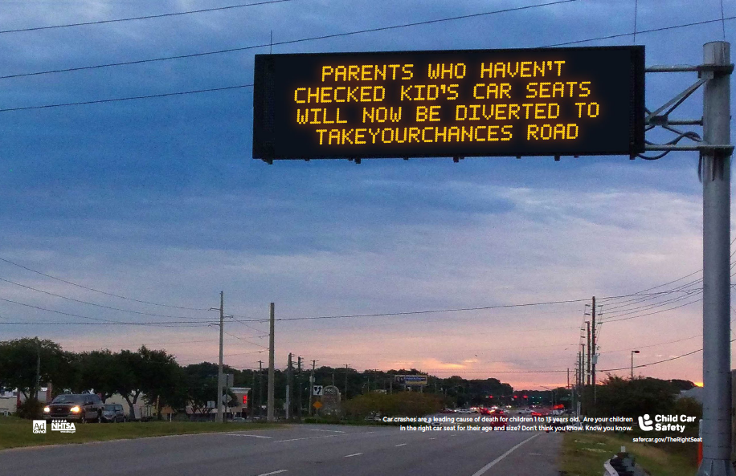
Reactions to Print
Your
Exit
Future
Messaging in the print ads was clear; however, messaging in some of the ads was perceived as too silly and/or forceful and signage was difficult to read. Additionally, the highway billboard imagery generated some confusion.
Reactions by Execution
Straight forward play on words; easier to read than in other print executions. Suggestive tone (e.g. ‘please exit’) appealing. | Perceived to be very forceful, threatening, compared to being pulled over by the police. Sarcasm and humor not appealing or appropriate for the topic. | Phrase is awkward – raised concerns around grammar. Tone perceived as goofy, but forceful and compared to being pulled over by the police.
Reactions Overall
Statistics noticed by many, reinforces credibility. Tagline strong and powerful, but not pronounced enough in the ads. Some were confused by signs – perceived to be actual signs on the highway. Some mentioned URL, but was perceived as too small.
Opportunities for optimization
Use a more suggestive tone (e.g. ‘please exit’) rather than commanding tone (e.g. ‘merge immediately’) to avoid associations with being pulled over by police. Avoid using phrases or play on words that might be perceived as goofy or humorous. Make tagline and stats more pronounced to maximize impact and create stronger call to action.
Page 16

Slide 17
Conclusions and Potential Implications

Slide 18
Conclusions and Potential Implications
If moving forward with ‘Dash Cam’, consider optimizing as follows: |  | If moving forward with ‘Your Exit” consider optimizing as follows:
TV: Consider incorporating imagery/audio of children and/or car seats into the executions to strengthen connection between ad and message. Radio: Avoid over-confident tones in voices that run the risk or being perceived as arrogant and neglectful. Consider the use of voices that reflect uncertainty and concern to more strongly connect with the target audience. Casting will be key to ensure proper tone is communicated. Print: Avoid using tones that can be perceived as too harsh. Consider incorporating a provocative question that makes the reader stop and think. |  | TV: Change tone of music to match the seriousness of the topic. Radio Consider providing different types of metaphors (not just highway related) to keep listeners engaged in spot. Consider the number of metaphors to keep listeners engaged. Inject more energy into the spot, while maintaining the serious tone. Print: Use a more suggestive tone (e.g. ‘please exit’) rather than commanding tone (e.g. ‘merge immediately’) to avoid making audience feel threatened. Avoid using phrases or play on words that might be perceived as goofy or humorous.
Opportunities for optimization that apply to all executions across both campaigns
Ensure tagline and statistic are highlighted to reinforce message, maximize impact and create stronger call to action. Make URL website more pronounced in TV to further facilitate the call to action.
Of the two campaigns tested in this research, Dash Cam performed best, though each had their strengths and challenges.
In ‘Dash Cam’, the imagery together with the tagline created a strong sense of urgency, but opportunities to optimize exist, particularly for the radio and print.
Many liked ‘Your Exit’ for its softer tone, and the radio spot resonated; however, overall this approach struggled to create a sense of urgency. The signage in the TV and print also generated some confusion.

Slide 19
Conclusions and Potential Implications
 | Imagery of child in car seat and parent connects ad to message – important in differentiating ad and drawing target audience into message. Serious, but not overly harsh tone in ads align with topic of child passenger safety and was perceived to be appropriate. Characters that depict parents who are uncertain but concerned about their child’s safety reflects how parents see themselves and resonates with target. Tagline that is prominently incorporated into ad is powerful and compelling. Statistic reinforces messaging and credibility. URL that is prominently shown or announced is appreciated and recalled.
 | Tone that is too harsh turns parents off and detracts from the main message. Tone that is too humorous (e.g. silly, exaggerated, goofy) perceived to be inappropriate for a serious topic like car safety. Tone that is too forceful or commanding also does not resonate – potential to make target feel threatened. Imagery of parents who are overly confident and make assumptions about their child’s safety perceived as irresponsible and idiotic, caused parents to disassociate from the ad. Absence of children in the executions – made it more difficult to connect messaging to ad.
Elements that worked and should be considered
Elements that did not work and should be reconsidered

